Slide 1
Binary, Chi-square, associations
Moses Ngari

Slide 2
Objectives
Present binary data
Calculate proportions & standard error of the proportion
Use standard error to calculate 95% CI and to test hypothesis
Use Chi-squared test.
Odds ratios and Risk ratios.

Slide 3
Binomial distribution
Variable takes value 0 or 1
seropositive / seronegative
yes / no
Parameter of interest is a proportion, p
n people in a sample
r experience the event of interest
sample proportion = p = r / n
Use sample data to get estimate of population parameter (π)

Slide 4
Binomial Distribution
Binary data follow the binomial distribution
Use p to estimate probability (or risk) that an individual from the population will experience event
Recall
We cannot estimate the population proportion
We use sample proportion to estimate it
There is uncertainty in the sample estimate
Aim to get a sample representative of the population
Take a random sample from the population

Slide 5
Example
Sample: 641 babies born in clinic
Interested in: proportion with low birth weight
Need: number of weight values < 2500 kg = 80
Proportion of babies with low birth weight
= 80 / 641
= 0.125 (12.5%)

Slide 6
Bias
Are these babies representative of a wider population?

Slide 7
Bias
Are these babies representative of a wider population?
Born in clinic
All babies or a sample ? Random sample ?
Problems in pregnancy ?
Higher SES ?

Slide 8
Bias
Are these babies representative of a wider population?
Wider population:
babies born in this clinic ?
babies born in clinics in this area ?

Slide 9
Sampling Variation
Assume representative random sample
Prob (baby born with low weight) = 0.125
Prob (born with normal weight) = 0.875
Use binomial distribution
To estimate prob (r babies born with low weight)
For any values of r, π and n
Example of how to calculate probabilities in notes

Slide 10
Sampling Variation
population proportion = 0.125 for different values of n
n = 10 n = 20 n = 50
Normal approximation to the binomial distribution

Slide 11
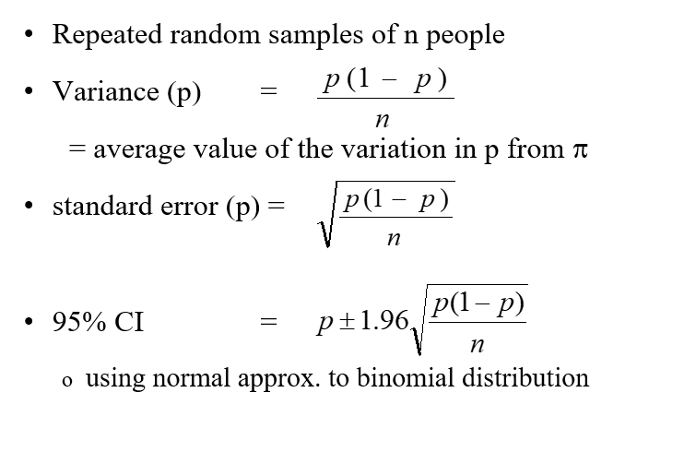
Variation in p

Slide 12
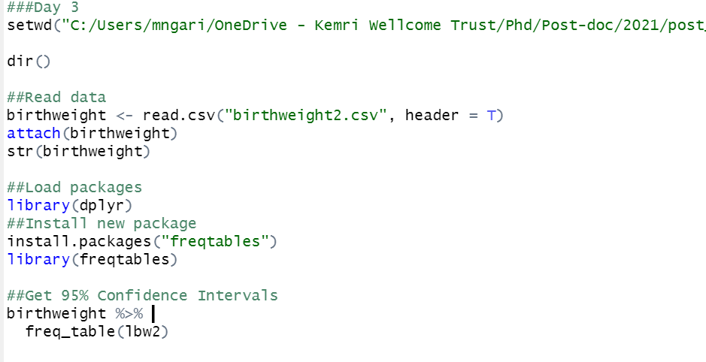

Slide 13
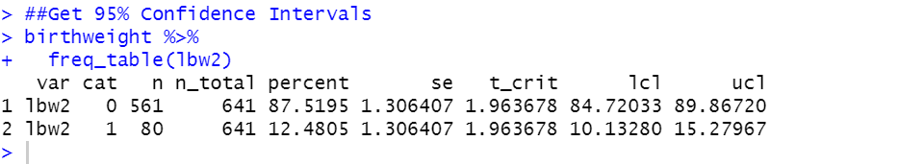

Slide 14
Summary: Basic tools for the analysis of binary data:
Descriptive: Bar charts, and tabulation of the data
Analytic : Creating 95% CI and
Hypothesis testing.
1. Assuming approximation, use prop.test()

Slide 15
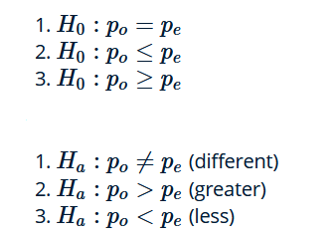
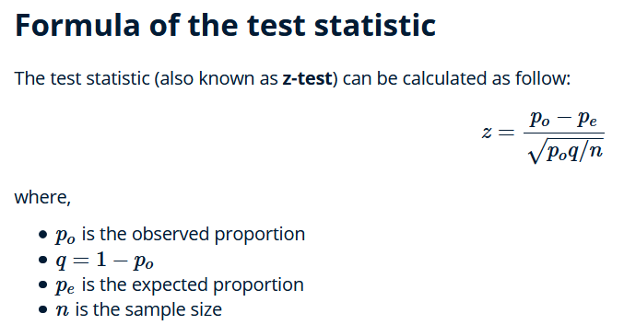
Proportions: hypothesis testing

Slide 16
Analysing Low birth weight
Use birthweight2
Check the variables, and explore the data.
Look at the variable lbw, it is coded 0=LBW, 1=Normal
Get the proportion of low birth weight babies and 95% CI.
Test the hypothesis that p=0.90 (90% normal BW)

Slide 17
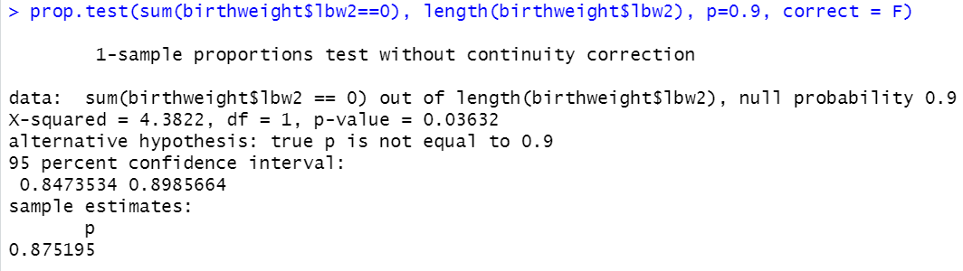
prop.test(sum(birthweight$lbw2==0), length(birthweight$lbw2), p=0.9, correct = F)
correct: a logical indicating whether Yates’ continuity correction should be applied where possible.

Slide 18
Chi- squared test - Comparing proportions - chi-squared test
Comparing two (or more) proportions
– the Chi-squared test uses Expected numbers.
Chi-squared test is valid for any contingency table
Assumptions: sufficient numbers in each cell of the table
1 State the null hypothesis: No association between the two variables.
2 Calculate the expected numbers for each cell.
3 Calculate the Chi-squared statistic from the Observed and Expected
numbers
4 Test against the chi-squared distribution.
5 Obtain the p-value for the data, under H0

Slide 19
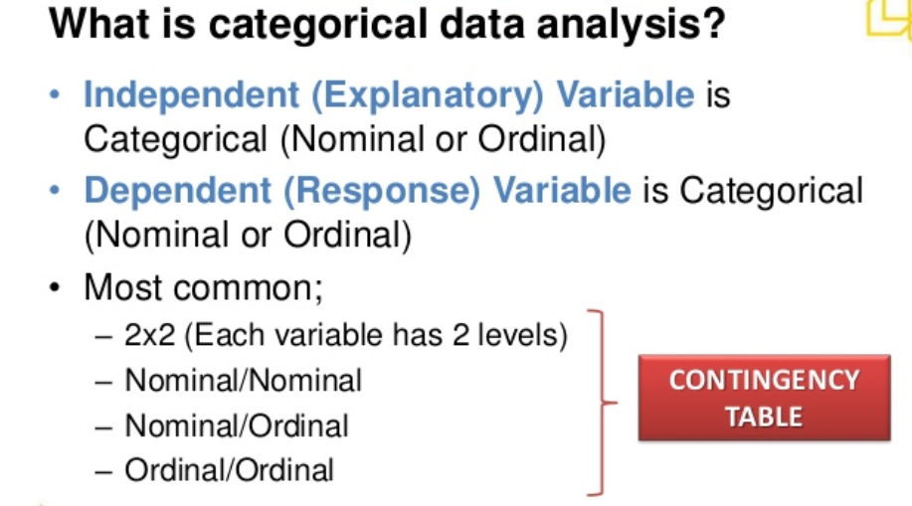

Slide 20
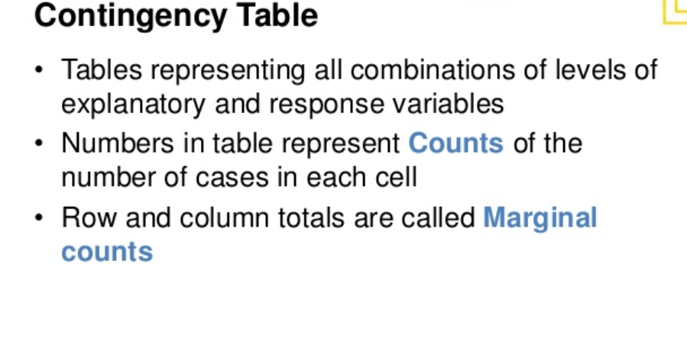

Slide 21
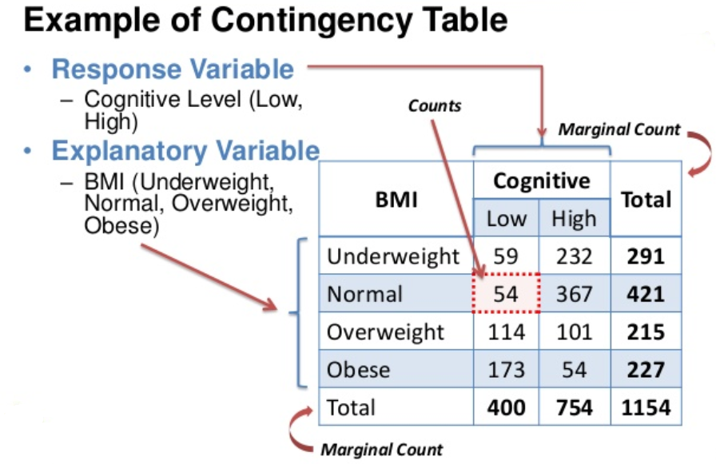

Slide 22
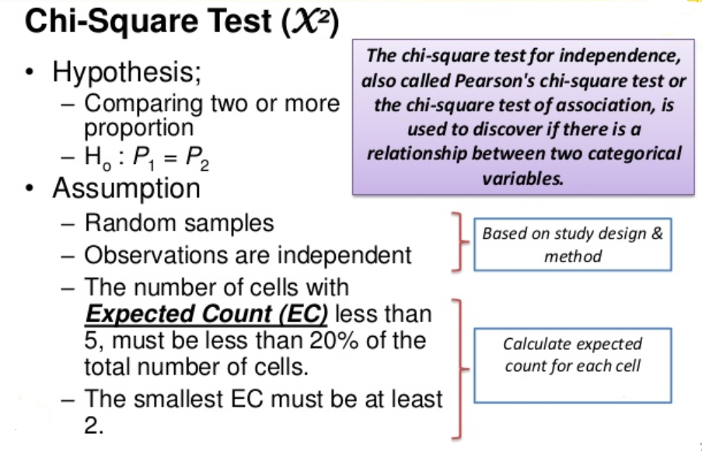

Slide 23
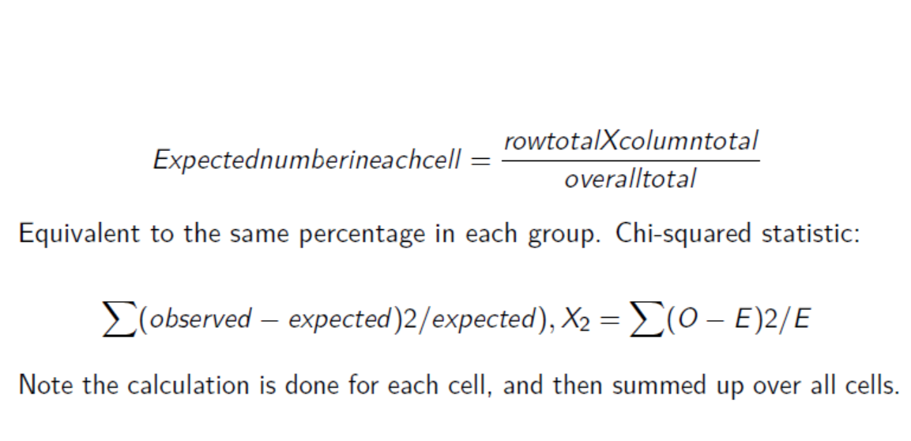
Chi-squared test – the calculations

Slide 24
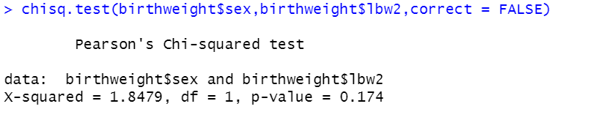

Slide 25
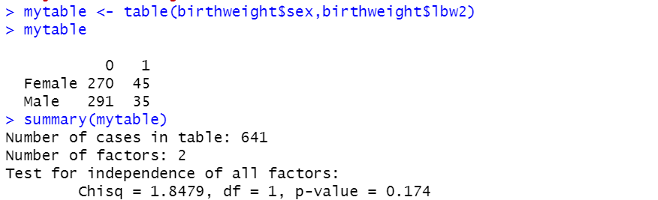

Slide 26
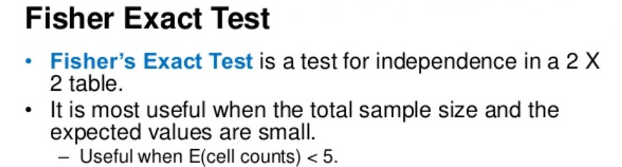
Contingency tables – the exact test

Slide 27
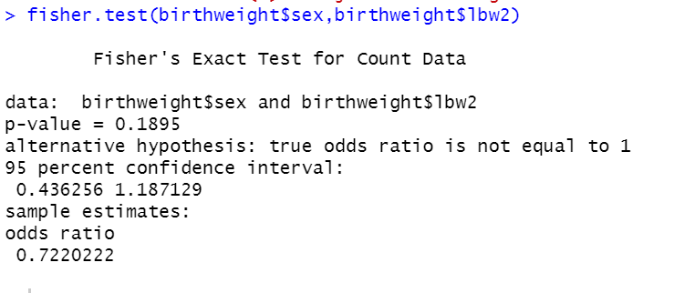

Slide 28
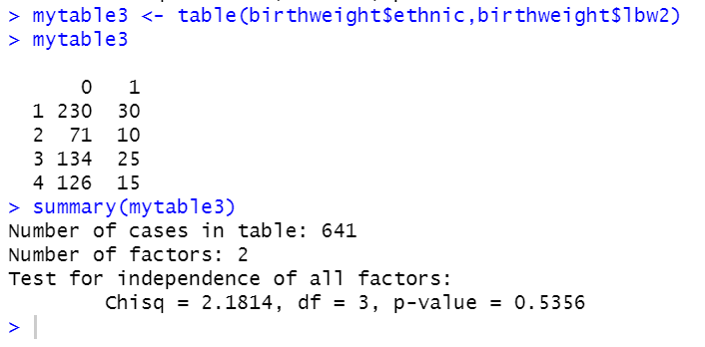
Chi-squared test - for larger tables

Slide 29
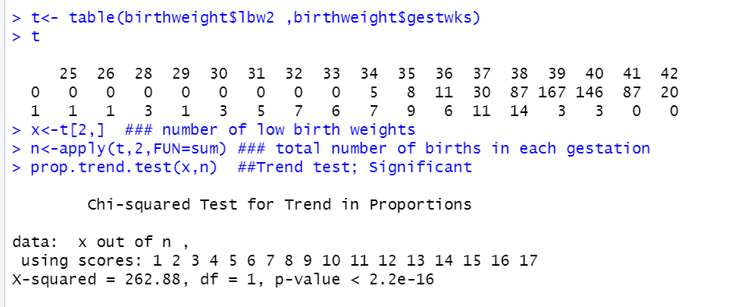
Chi-square test of trend

Slide 30
Analysing Low birth weight
Use birthweight.csv, with outcome low birth weight (lbw)
Ensure you have the variable that shows 1= LBW, 0=Normal
Look at the association between lbw and hypertension (ht), using the chi-squared test

Slide 31
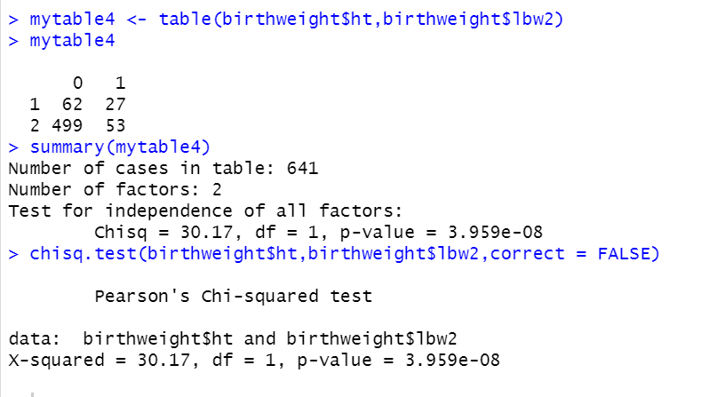

Slide 32
Effect estimates for binary data
Measures of association
Objectives:
1 To define risk ratios, odds ratios and other measures of association
2 How to get standard errors for risk ratios and odds ratios, and to use these to obtain 95% CI for these measures.
How to obtain these measures in R
When the different measures are used.

Slide 33
Measures of association
Three measures to quantify the magnitude of the effect when comparing two proportions:
Ratio p₂/p₁
Difference p₂-p₁
Odds ratio [p₂/(1-p₂)]/[p₁/(1-p₁)]

Slide 34
Ratio measures in epidemiology:
Used in aetiological studies of causes of disease as a measure of
strength of association: how much does an exposure multiply up
your risk
smokers 10x more likely to develop lung cancer than non-smokers. Risk ratio=10.
Difference measures:
Used as measure of excess risk due to an exposure.
The risk of HIV infection in children born to HIV infected mothers:
mothers who do not breast feed, risk is 180/1000
mothers who breast feed, risk is 380/1000
Risk difference (380-180)/1000 = 200/1000
Interpretation: breast feeding was responsible for the infection of 200 out of every 1000 babies born to HIV infected mothers who breast fed. <assuming causative link…>
We are interested in the potential impact of an intervention.

Slide 35
Two types of ratio measure: Risk ratio and odds ratio
Risk ratio = Risk of disease in exposed group
Risk of disease in unexposed group
Can be estimated from cohort studies and randomized trials
Cannot be estimated from case control studies
Odds ratio = Odds of disease in exposed group
Odds of disease in unexposed group
Can be estimated from case control studies

Slide 36
Risk ratio (RR)
Prevalence ratio (risk ratio) = Prevalence in exposed group
Prevalence in unexposed group
 | Exposed | Unexposed | Total
Disease | a | b | (a+b)
No disease | c | d | (c+d)
Total | (a+c) | (b+d) | N
RR = p₂/p₁
= a/(a+c)
b/(b+d)

Slide 37
Risk ratio (RR)
Prevalence ratio (risk ratio) = Prevalence in exposed group
Prevalence in unexposed group
RR = p₂/p₁
= a/(a+c)
b/(b+d)
 | Exposed | Unexposed | Total
Disease | a | b | (a+b)
No disease | c | d | (c+d)
Total | (a+c) | (b+d) | N
The SE and confidence interval are best estimated on the log scale.
It can be shown that the SE of the log RR can be written as:
SE for the log(RR) = √{1/a – 1/(a+b) + 1/c - 1/(c+d)}

Slide 38
Odds ratio (OR)
Odds ratio (OR) = Odds in exposed group
Odds in unexposed group
OR = a/c
b/d
Again the SE is best estimated on the log scale.
 | Exposed | Unexposed | Total
Disease | a | b | (a+b)
No disease | c | d | (c+d)
Total | (a+c) | (b+d) | N
SE for the log(OR) = √{1/a + 1/b + 1/c + 1/d}
For both RR and OR, the Standard errors can be used to create 95% CI and to test hypothesis, on the LOG scale.

Slide 39
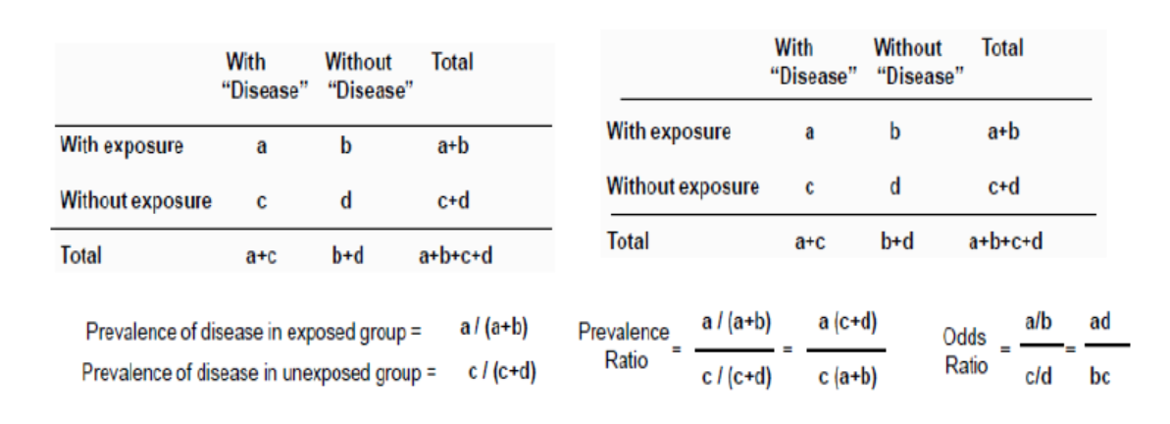

Slide 40
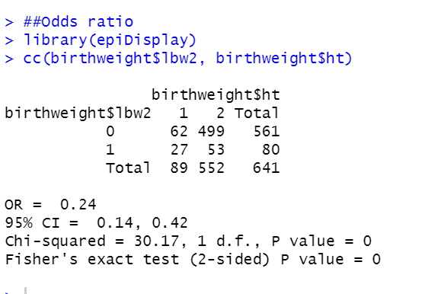
Odds ratio in R

Slide 41
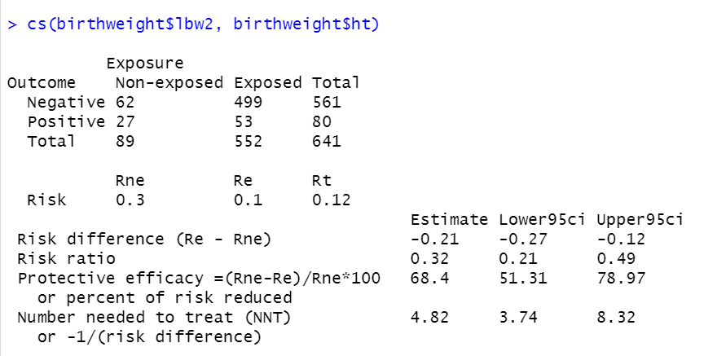
Risk ratios in R

Slide 42
Practical
Use the same dataset birthweight.csv
Test if LBW was associated with agegrp1 (hint: risk ratio)

Slide 43
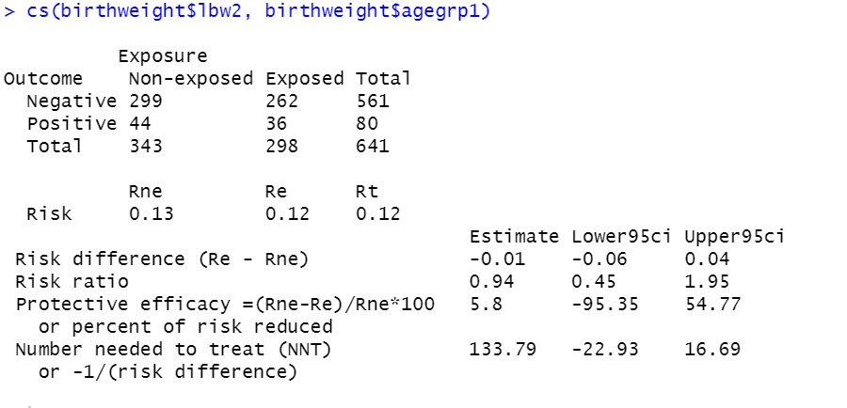

Slide 44
Summary
Standard errors can be obtained on the log scale, and used to obtain 95% CI and to test hypothesis
Several commands in R to obtain odds ratios, and risk ratios.
For cc, and cs functions, make sure you have the coding right.

Slide 45
Odds ratio for matched data
Analysis of matched binary data is more difficult than unmatched binary data (unlike for continuous data). Analysis of matched data must take the matching into account in the analysis.
Two ways of analysing matched data:
McNemars test. A chi-squared test on the observed data.
Analysis of discordant pairs using Odds ratio (OR).

